Slide 2
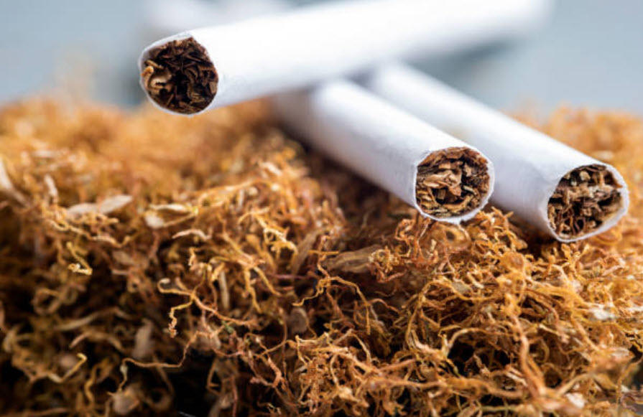
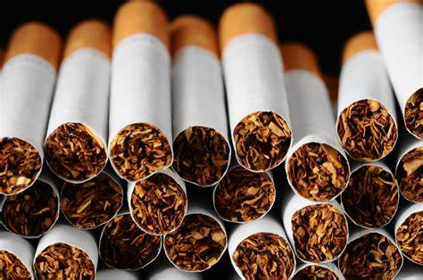
What is TOBACCO
Tobacco is “Dried leaves of Tobacco plant”

Slide 3
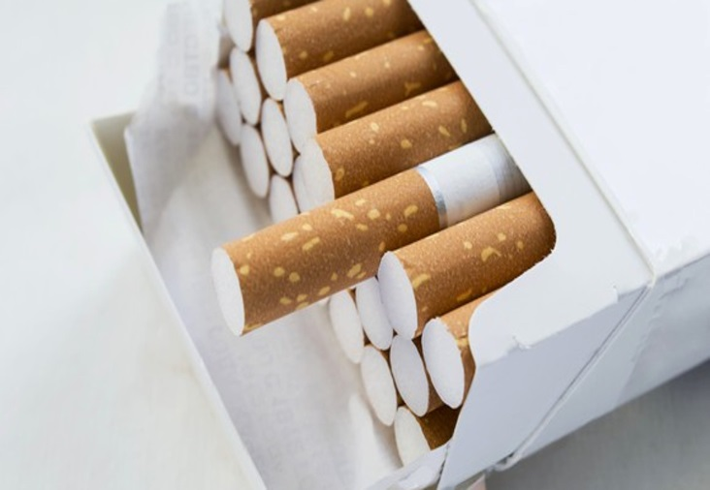
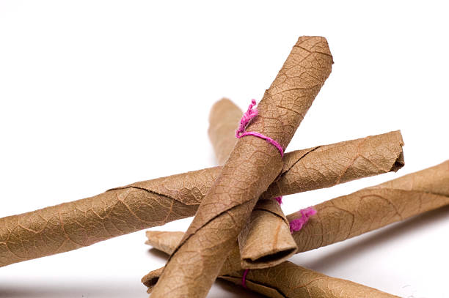
Tobacco consumption method
1. IN FORM OF CIGARETTES :
2. IN FORM OF BIDDIS:

Slide 4
TOP RANKING COMPANIES ….
M.R Tobacco
ITC COMPANY
Sudarshan Tobacco
Etc.

Slide 5
RANKING OF INDIA
* TOBACCO PRODUCTION : THIRD
TOBACCO CONSUMPTION : THIRD
EXPORT OF TOBACCO : SIXTH

Slide 6
ADVERTISEMENT
DIRECT
INDIRECT
television, radio, print publications, billboards and social media platforms.
brand sharing, brand stretching, free distribution, price discounts

Slide 7
HAZARDS
SHORT TERM EFFECT
LONG TERM EFFECT
VOMITTING
STOMACH CRAMPS
DIARRHEA
CHEST PAIN
HIGH LOW BP
IRREGULAR HEARTBEAT.
THYROID
METABOLIC SYNDROME
LIVER TOXICITY
DIABETES
ABNORMAL KIDNEY.

Slide 8
OTHER HAZARDS
BREATHING REACTION
BODY REACTION
TOXICITY
CARCINOGENIC EFFECTS

Slide 9
QUITING TOBACCO
When tobacco users become aware of the dangers of tobacco, most want to quit. However, nicotine contained on tobacco products is highly addictive and without cessation support only 4% of users who attempt to quit tobacco use will succeed. Professional support and proven cessation medications can more than double a tobacco user's chance of successful quitting.

Slide 10
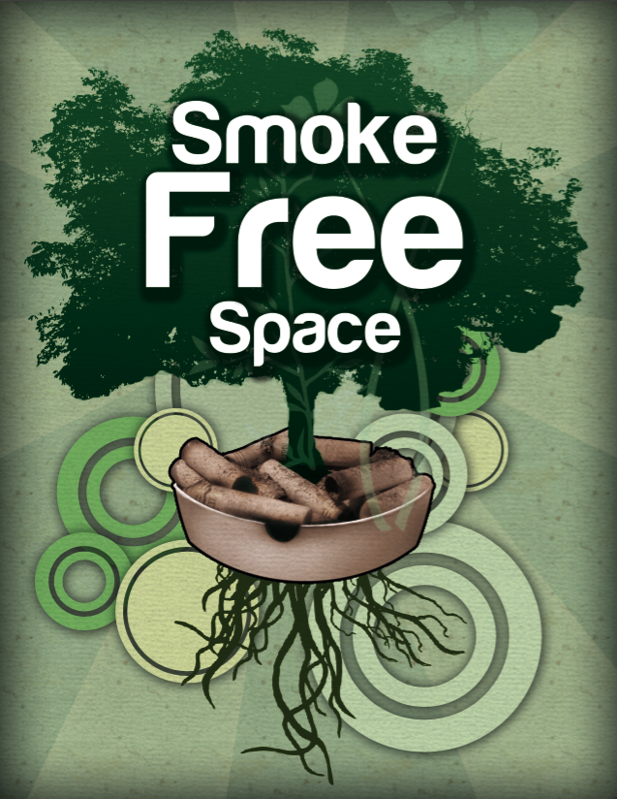
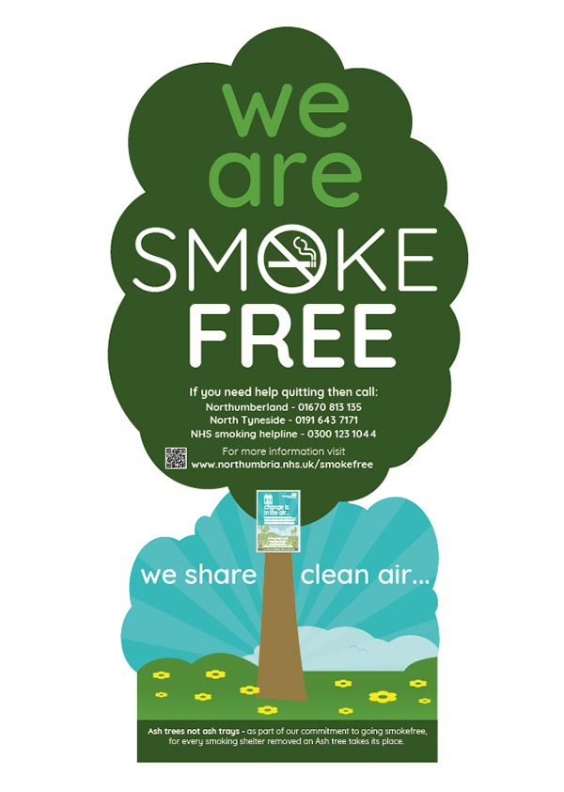
SMOKE FREE ENVIRONMENT:

Slide 11
STEPS FOR QUITING
DRINK LOT OF WATER AND FLUIDS.
STAY AWAY FROM ALCOHOL, SUGAR AND FATTY FOODS.
INSTEAD OF CIGARETTES TREAT YOUSELF A CUP OF MINT TEA.
TELL YOUR FRIENDS AND RELATIVES NOT TO SMOKE IN YOUR PRESENCE.

